Slide 1
NIDEC CORPORATION
ESP8266 and IoT application.
Builder: MR.LONG
Date: 13-Dec-17

Slide 2
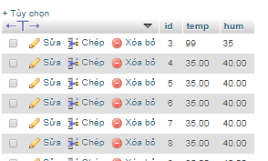
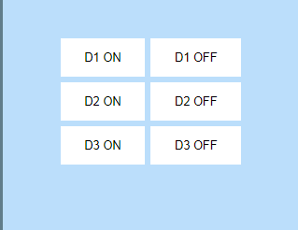
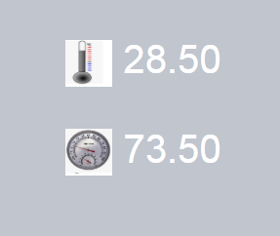
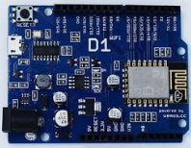
Layout data.
Mysql. database
php.
webhosting
Query data.
Using
html, css, js.
select
Query
Update, insert
Query
Esp8266.
Using c, c++
WiFi.begin(ssid, password);
client.connect(yourweb, 80));
Read/update data

